Slide 1
String
In C#, you can use strings as array of characters, The string keyword is an alias for the System.String class.

Slide 2
String
Creating a String Object
You can create string object using one of the following methods:
By assigning a string literal to a String variable
By using a String class constructor
By using the string concatenation operator (+)
By retrieving a property or calling a method that returns a string
By calling a formatting method to convert a value or an object to its string representation

Slide 3
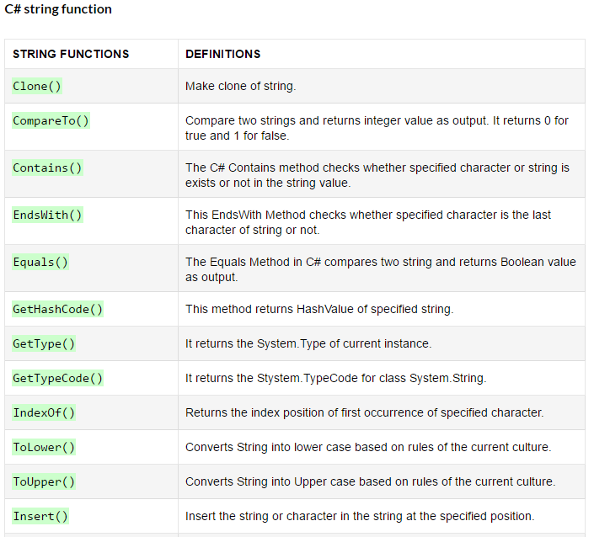

Slide 4
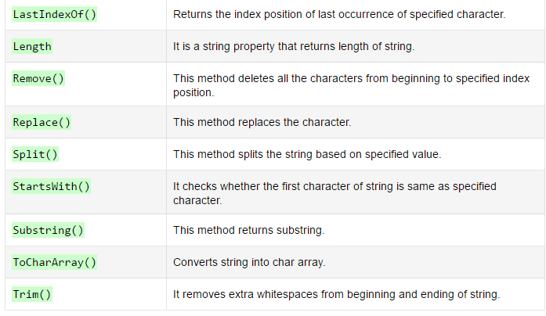

Slide 5
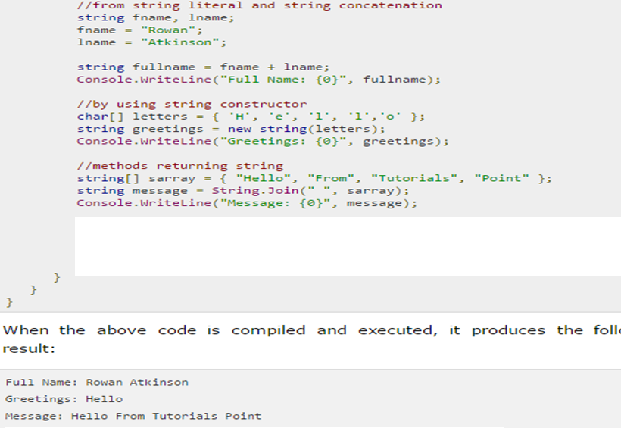
String

Slide 6
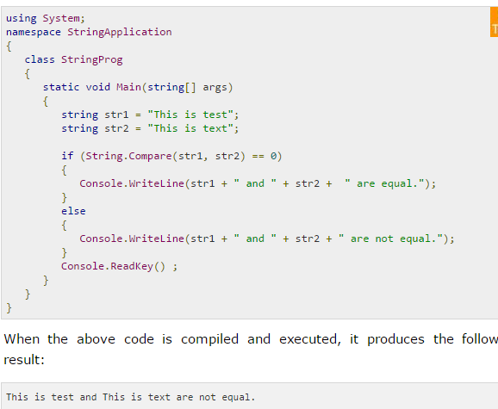
public static int Compare(string strA, string strB)Compares two specified string objects and returns an integer that indicates their relative position in the sort order.

Slide 7
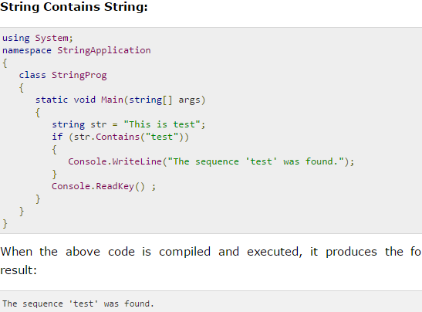
public bool Contains(string value)Returns a value indicating whether the specified String object occurs within this string.

Slide 8
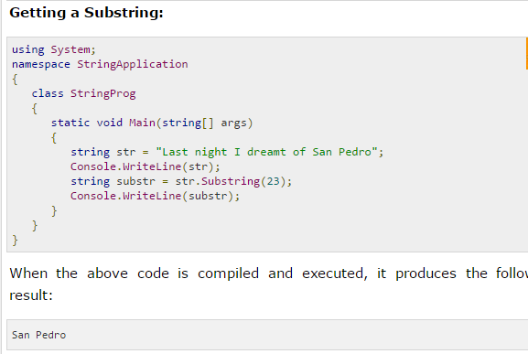

Slide 9
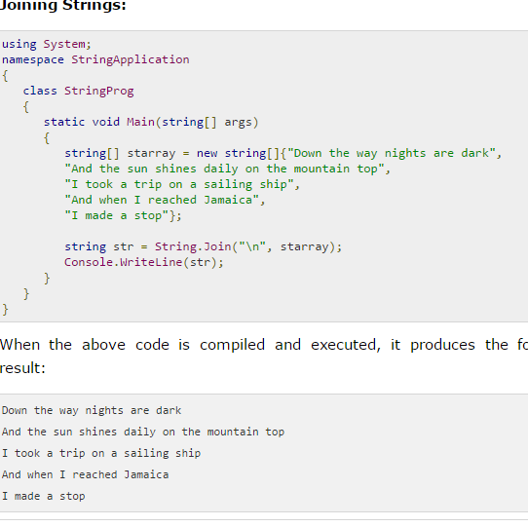

Slide 10
Generics
What are Generics
In simple words, Generics are the that type of classes which has PalceHolder instead of datatypes. When you create generic classes you don’t specify its data type; datatypes are defined when you create objects. This makes Generic classes reusable and type-safe and your Generic classes and methods are able work with any datatypes.
More about Generics
Generics improves code usability, type safety and performance.
Mostly Generics are used for creating collection classes.
You can use Generics by adding System.Collections.Generic namespace.
You can create your own Generic interfaces, classes, methods, events and delegates.

Slide 11
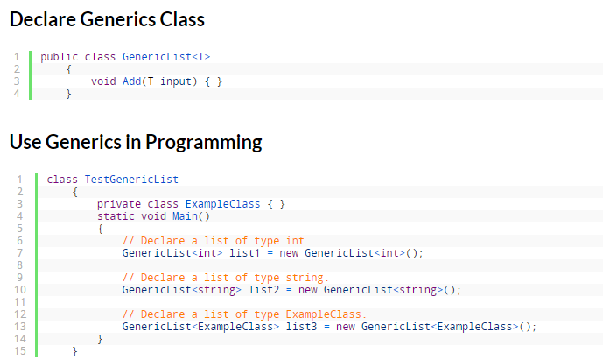
Generics

Slide 12
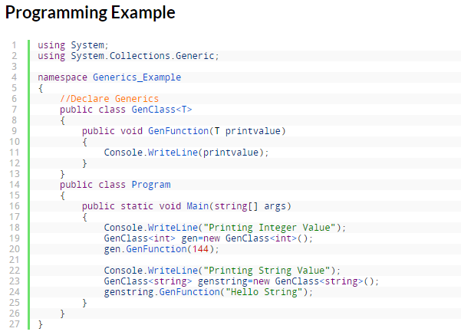
Generics

Slide 13
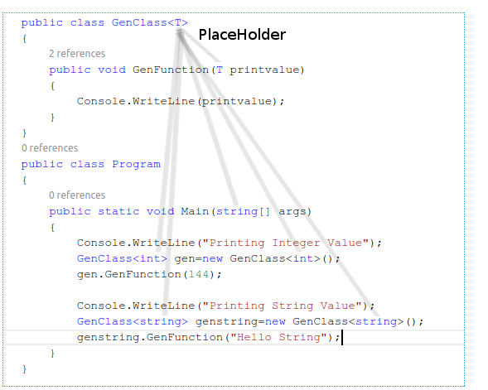
Generics

Slide 14
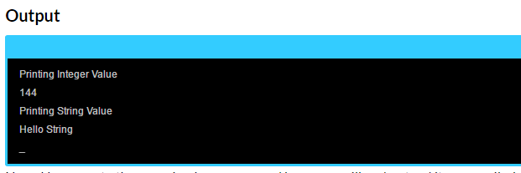
Generics

